Slide 1
Chapter 5- Health-Compromising Behaviors

Slide 2
Agenda
2
Aspects of Health-Compromising Behaviors
Obesity
Eating Disorders
Addiction and Substance Use
Self-Harm
Resources

Slide 3
Public Service Announcement
Please be considerate during the conversations we have today. Many of the health behaviors we will discuss masquerade as invisible. You never know what the people around you have experienced (first, second, or third hand), so please operate with kindness and compassion. This class is meant to facilitate tough conversations about health, but that is only possible as long as we all act with respect, openness, and a willingness to listen.

Slide 4
Health-Compromising Behaviors
Most risky behaviors feel “good” or are in some way rewarding
Multiple behaviors can be considered health-compromising
Substance use
Obesity and eating disorders
Unprotected sex
Self harm
Many of these behaviors share underlying characteristics
Behaviors are habitual and addictive, but develop gradually
Adolescence is (usually) the window of vulnerability
Can be caused by stress and/or peer pressure

Slide 5
Obesity
Obesity – an excessive accumulation of body fat
U.S. has the largest proportion of individuals struggling with obesity
68% of the population is overweight, 40% classify as obese
Potential Ramifications:
Reduces cancer survivability
Cardiovascular disease
Shortened life-spans
Weight stigma can undermine weight loss efforts by increasing stress
Cycles of weight gain and yo-yo dieting lower metabolic rate and increase chances of obesity

Slide 6
Eating & Image Disorders
Anorexia nervosa – an obsessive disorder where an individual will severely restrict their food intake
Bulimia – a disorder characterized by cycles of binge eating and purging
Purging can include vomiting, laxative abuse, extreme dieting/ fasting, and substance abuse
Binge-eating – a disorder characterized by excessive eating, often to the point of feeling sick
Body dysmorphic disorder – a preoccupation with a perceived defect in one’s physical appearance
Excessive exercise – a health-compromising behavior where an individual feels the compulsory need to exercise, to the point of damaging one’s self

Slide 7

https://www.youtube.com/watch?v=7VZNGgDjsMo

Slide 8
Addiction
Addiction – when a person has become physically or psychologically reliant on a substance
lasts a person’s lifetime
Physical dependence – changes in bodily functions that can cause withdrawal symptoms upon cessation of use
Psychological dependence – user is emotionally reliant on drug, and stopping may cause severe psychological distress
Withdrawal – experiencing a variety of symptoms (ranging from agitation to possible death) when a person stops using a drug
Tolerance – when a person needs more of a drug to receive the desired effect due to extended use
Detoxification – the process of slowly reducing substance use, to prevent severe withdrawal symptoms

Slide 9
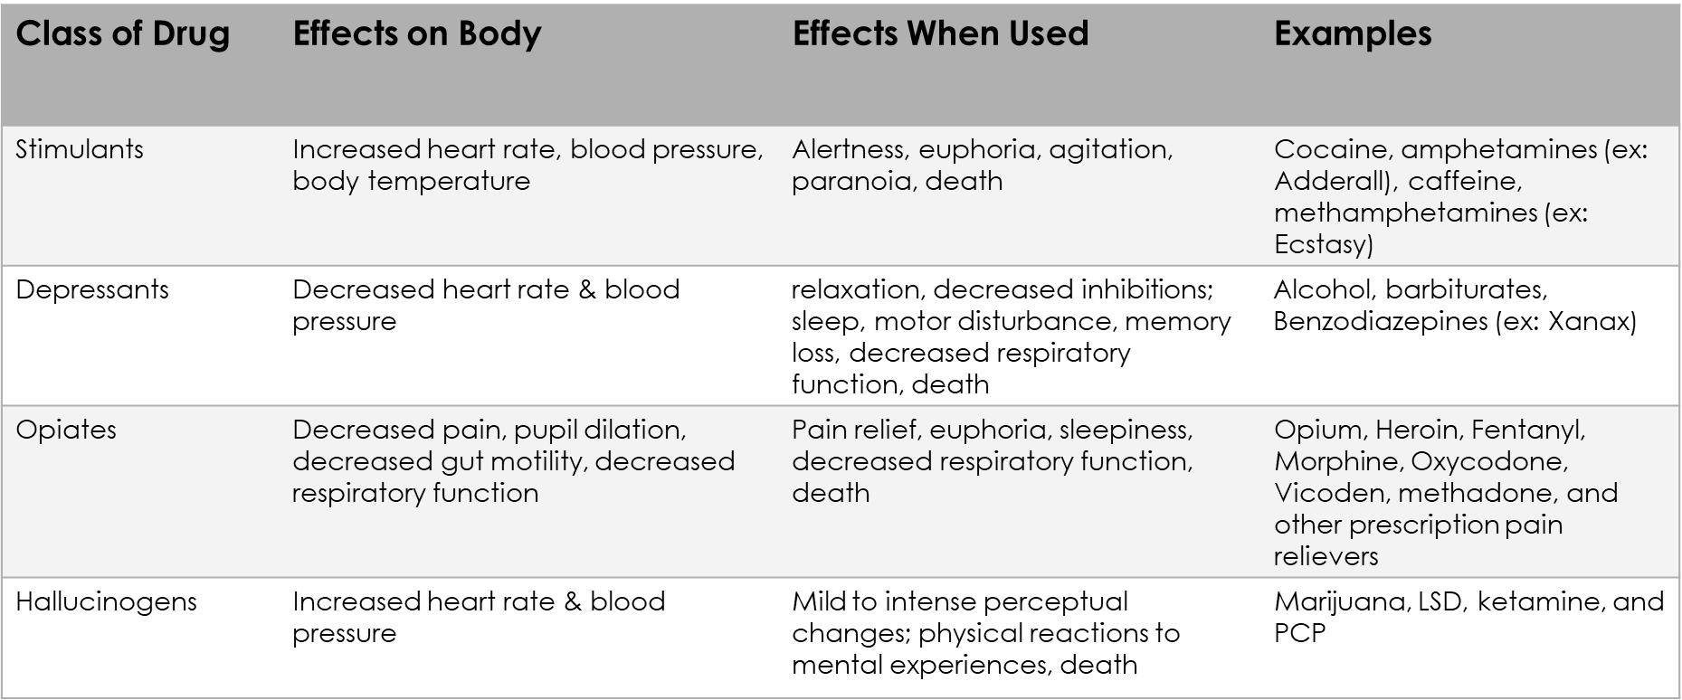
Classifications of Drugs

Slide 10

https://www.youtube.com/watch?v=hBC7i-vHWsU

Slide 11
Common Addictions
Alcoholism
Smoking – Nicotine and Marijuana
A reliance on alcohol, which often includes a high tolerance, difficulty stopping, and withdrawal symptoms
Treatments include CBT and support programs like Alcoholics Anonymous
Often linked to stress & coping
Smoking causes 9 out of 10 lung cancer deaths
Transition from cigarettes to vapes
Myth = marijuana is not addictive
Marijuana has been linked with depression, anxiety, lung damage, cognitive decline, and compromised heart health

Slide 12
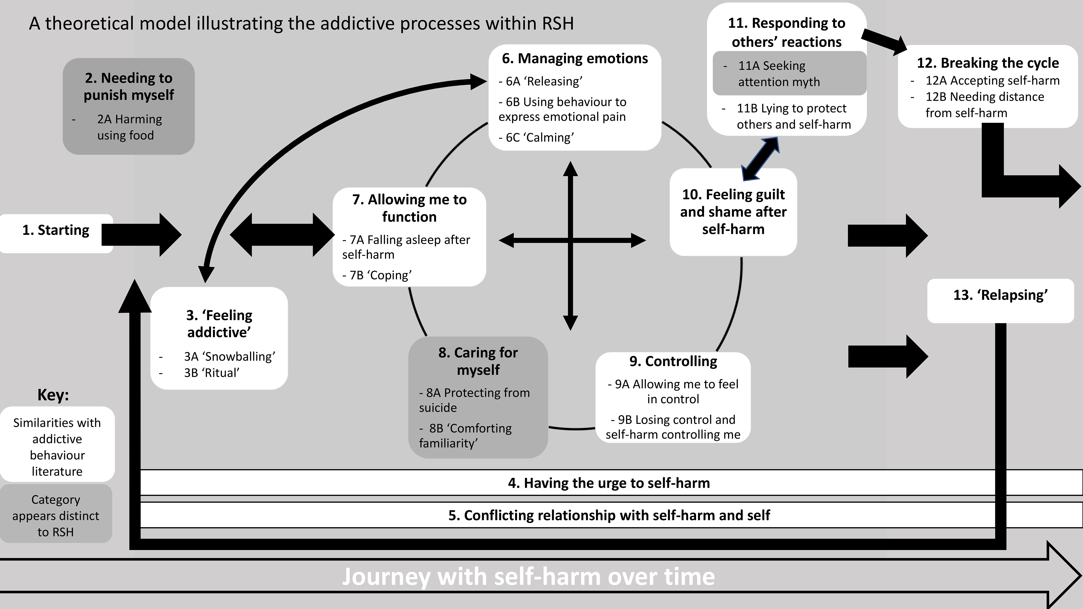
Self Harm
Multiple driving factors, including relieving mental pain and gaining control
Self-harm myths:
Attention seeking
Self-harm = suicidal ideation
Self-harm is limited to cutting
Self-harm = manipulation attempt
https://doi.org/10.1371/journal.pone.0328914.g001

Slide 13
Resources
To Write Love on Her Arms
https://twloha.com/find-help/help-by-topic/self-injury/
Substance Abuse and Mental Health Services Administration
https://www.samhsa.gov/
National Alliance for Eating Disorders
https://www.nationaleatingdisorders.org/
Student Reporting Labs (provides lists on resources and info)
https://studentreportinglabs.org/mentalhealthresources/
Alcoholics Anonymous (AA) and Narcotics Anonymous (NA) meetings in Kearney
https://betteraddictioncare.com/meetings/nebraska/kearney/

Slide 14
Next time on PSY 440…
Before Next Class:
In Our Next Class:
Review BCP Feedback
Begin Behavior Change Data Collection
Runs 2/9 to 2/13, so you will begin before we see each other next
Study for Exam 1
Exam on Wednesday, 2/11
Discussion Board Extra Credit
Class activity
Note: We will continue discussions on difficult topics like addiction. Please be aware of your mental health and boundaries you may need to set for yourself.

